Slide 1
Control System
Electronics
Pneumatics
Motors | Motor Controls | Relays | Amp Breaker
Drivetrain | X |  | 40
Drivetrain | X |  | 40
Drivetrain | X |  | 40
Drivetrain | X |  | 40
Collector Arm |  |  | 40
Collector Arm |  |  | 40
Collector Arm |  |  | 40
Collector Arm |  |  | 40
Collector Arm |  | X | 40
Collector Arm |  | X | 40
Collector Pivot |  | x | 40
Collector Pivot |  | x | 40
Elevator | X |  | 40
Claw |  | X | 40
Claw |  | X | 40
Conveyor main | X |  | 40
Conveyor fr wheel | X |  | 40
Total | 11 | 6
Pistons | Solenoids
claw in/out | x
claw clamp | x
elevator | x
elevator | x

Slide 2
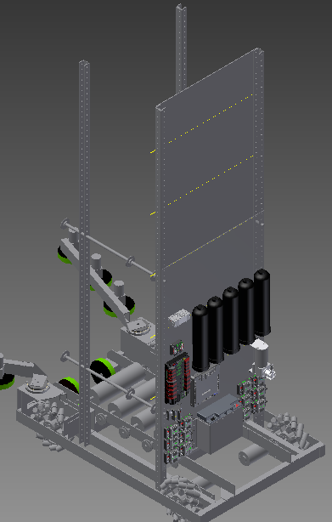
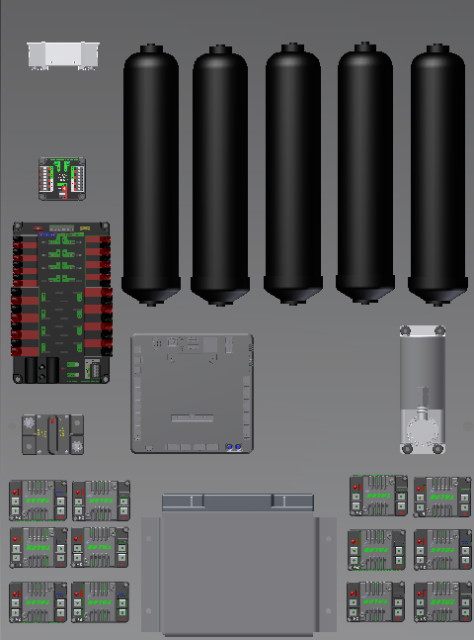
Position On the bot

Slide 3
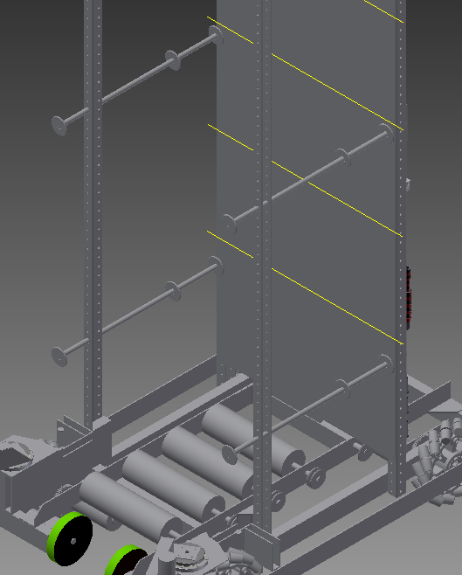
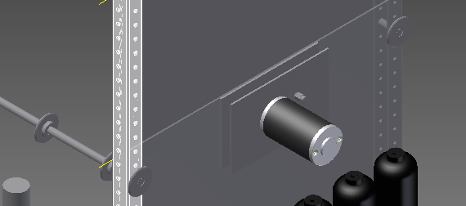
Elevator
Force of motors
Motor Stall Torque(ft*lb) | radius of Sprocket(ft) | Force of motor(lb)
16.6 | 0.0625 | 265
 | 0.0833 | 199
Speed of Chain
Free spin Speed (RPS) | Inches of chain/Rotation
1.25 | 4.712 | 5.89
 | 6.283 | 7.85375

